Slide 1
ROS-Industrial Basic Developer’s Training Class
4 June 2014
Shaun Edwards
Sr. Research Engineer
Southwest Research Institute

Slide 2
Overview

Slide 3
Overview Presentation
See “What Can ROS-I Do Today?” presentation

Slide 4
Introduction to ROS-I (Users & Developers)

Slide 5
Outline
Community
Wiki Documentation
Getting Help
Installing ROS

Slide 6
Objectives
Learn how to participate and interact in the community
Understanding of ROS/ROS-I wiki
Know where and how to ask for help
Be able to install ROS-I from binary and source
Entertain you ☺

Slide 7
ROS-I is a Community
Members: users, developers, researchers, bystanders, star trek fans(not star wars)
Resources:
Wiki – http://ros.org/wiki/Industrial
Email– http://groups.google.com/group/swri-ros-pkg-dev
Forums – http://answers.ros.org/questions/
Repos (migrating to Github)
http://code.google.com/p/swri-ros-pkg/
http://github.com/organizations/ros-industrial

Slide 8
ROS-I is a Community
Resources(cont):
Twitter - https://twitter.com/ROSIndustrial
Blog - http://rosindustrial.tumblr.com/
YouTube channel - http://www.youtube.com/channel/UCXyGVRiCwUMc1gav-G7z2ew

Slide 9
ROS-I is a Community
Community is managed, organized, and monitored by SwRI & RIC
Monitored: Wiki, Group emails, Forums
Access Controlled: Repos, Twitter, Blogs, YouTube channel

Slide 10
ROS-I Wiki
A Wiki is a website which allows people to add, modify, or delete the content via a web browser usually using a simplified markup language or a rich-text editor. (http://en.wikipedia.org/wiki/Wiki)
It’s a Wiki, YOU can edit it!

Slide 11
ROS-I Wiki
The ROS/ROS-I wiki contains documentation for users(focus) and developers
Documentation organized according to packages & stacks/meta-packages

Slide 12
ROS-I Wiki
Typical Content
Users
Developers
Overview
Tutorials
Architecture/Design
Code API
Dependencies
Bug Tracker

Slide 13
Wiki Walkthroughs
ROS-I Wiki(follow): http://ros.org/wiki/Industrial
ROS-I Package Wiki (simple_message)(follow): http://ros.org/wiki/simple_message

Slide 14
Getting Help
ROS Answers(follow): http://answers.ros.org/questions/
Developers List: http://groups.google.com/group/swri-ros-pkg-dev
Join here: https://groups.google.com/group/swri-ros-pkg-dev/boxsubscribe

Slide 15

Getting Help
Submitting Bugs (not for any code I have written)
Google Code: http://code.google.com/p/swri-ros-pkg/issues/list
Github Code: http://github.com/organizations/ros-industrial/dashboard/issues
Good bug submission:
Setup, Steps to reproduce, Expected Results
Best bug submission ever:
Good submission + Test Code

Slide 16

Getting Help
Call Us(Consortium Members Only)
Paul Hvass W: 210-522-5823, Home: ….☺
Collaboration
Generally open source
Consulting
Whatever you want
Various IP terms

Slide 17
Installing ROS-I
Binary (using apt-get)
Source (repos)
Recommended for users
Stable
Easy
Required for developers
Google Code
Github (future)
Harder
Unstable*
Latest capability

Slide 18
Binary Install
Command line: sudo apt-get install <package>
ros-<version>-industrial-core
ros-<version>-industrial-desktop
ros-<version>-abb
ros-<version>-motoman
ros-<version>-fanuc
ros-<version>-adept
ros-<version>-universal-robotics

Slide 19
Source Install
Wiki instructions(follow): http://ros.org/wiki/Industrial/Install
Repository structure
Experimental stacks/meta-packages
Google Code vs. Github

Slide 20
Source Install (SVN)
Install latest Hydro Industrial Core(example)
Go to the wiki page for the industrial core stack/metapackage.
Verify the required dependencies are installed on your system (exercise)
Download the hydro version of the package to the current directory
Build the stack

Slide 21
Source Install (Git)
Install a patched version of Robot Models Tutorials (example)
Go to the ROS-Industrial github main page
Find the Git link to the robot_models_tutorials repo (it's a fork of the formal ros repo)
Move to the stack directory, and build the stack

Slide 22
Exercise
Exercise 4.1(follow) - https://aeswiki.datasys.swri.edu/rositraining/Exercises/4.1

Slide 23
ROS-I - Simple Message Layer (Core Developers)

Slide 24
Outline
Overall Architecture
Simple Message Package Overview
Messages and Connections
Managers and Handlers
Library Linking

Slide 25
Objectives
Understand the top-level ROS-I architecture
Be able to develop ROS-I simple message client/server applications
Understand how the simple message library can be used to bridge ROS messages to simple devices

Slide 26
Top Level Architecture
Notes:
Talk about different layers
Identify ROS-I App & Gui as future
Standard nodes are shown
Configuration data
Availability of ROS ecosystem, move it, and ros gui

Slide 27
Simple Message Detail
Bridge layer between ROS and Robot Controllers

Slide 28
Simple Message Package
Package Overview(follow): http://ros.org/wiki/simple_message
New Typed Messages (Post Hydro)
Joint Trajectory Pt Full (mimics ROS JointTrajectoryPoint) http://ros.org/doc/api/trajectory_msgs/html/msg/JointTrajectoryPoint.html
Robot Status (mimics ROS-I Robot Status) http://ros.org/doc/hydro/api/industrial_msgs/html/msg/RobotStatus.html
Notes:
Motivation
Simple Message
Typed Messages
joint
joint traj pt full
joint traj pt
robot status
Simple Message Connections
TCP Client/Servers
UDP Client/Servers (experimental)

Slide 29
Talker/Listener
Create 2 nodes, talker and listener
Send simple messages between nodes (NOT ROS messages)
Joint Simple
Message (request)
Talker
Listener
Joint Simple
Message (response)

Slide 30
Create an Eclipse Project
Make eclipse project files
Import project into eclipse
Enjoy modern IDE features like code completion, syntax checking, etc…
Do not check project files into repos (they aren’t portable)

Slide 31
Talker Node
// Initialize ROS node "sm_talker"
ros::init(argc, argv, "sm_talker");
// Required to start timers for non-node ROS use.
ros::Time::init();
// Little message to know she's started
ROS_INFO_STREAM("STARTING SM_TALKER");
// Create a TCP client connection to TCP_PORT on LOCAL_HOST (see common.h)
TcpClient client;
client.init(LOCAL_HOST, TCP_PORT);
while(!client.isConnected())
{
ROS_INFO_STREAM("Trying to connect to server");
client.makeConnect();
ros::Duration(0.5).sleep();
}
int seq = 0;
<continued>
while(client.isConnected())
{
// Create a message of type JointMessage and corresponding simple message
JointMessage jmReq;
SimpleMessage req, reply;
seq++;
jmReq.setSequence(seq);
jmReq.toRequest(req);
ROS_INFO_STREAM("Sending sequence number: " << seq);
client.sendAndReceiveMsg(req, reply);
ROS_INFO_STREAM("Received reply code: " << reply.getReplyCode());
ros::Duration(1.0).sleep();
}

Slide 32
Listener Node
// Initialize ROS node "sm_talker" ros::init(argc, argv, "sm_listener"); // Required to start timers for non-node ROS use. ros::Time::init(); // Little message to know she's started ROS_INFO_STREAM("STARTING SM_LISTENER"); // Create a TCP server connection on TCP_PORT (see common.h) TcpServer server; server.init(TCP_PORT); while(!server.isConnected()) { ROS_INFO_STREAM("Trying to connect to client"); server.makeConnect(); ros::Duration(0.5).sleep(); } while(server.isConnected()) { // Create a message of type JointMessage JointMessage jmReq, jmReply; SimpleMessage req, reply; ROS_INFO_STREAM("Waiting for client request"); server.receiveMsg(req);
if( req.getMessageType() == jmReq.getMessageType() ) { if( req.getCommType() == CommTypes::SERVICE_REQUEST ) { jmReq.init(req); ROS_INFO_STREAM("Received sequence number: " << jmReq.getSequence()); jmReply.toReply(reply, ReplyTypes::SUCCESS); server.sendMsg(reply); ROS_INFO_STREAM("Sending reply code: " << reply.getReplyCode()); } else { ROS_ERROR_STREAM("Unexpected comm type: " << req.getCommType()); } } else { ROS_ERROR_STREAM("Unexpected message type: " << req.getMessageType()); } }

Slide 33
Exercise
Exercise 4.2(Part 1) - https://aeswiki.datasys.swri.edu/rositraining/Exercises/4.2

Slide 34
Message Manager/Handler
Message manager/handlers simplify relaying simple messages (similar to ROS msg callbacks)
Allows multiple data streams to use the same connection

Slide 35
Library Linking
Simple Message compiled as a library for inclusion in other packages
2 versions compiled (normal, byte swapped)
Linking to Simple Message library (non-standard)
Example: http://ros.org/wiki/simple_message#Library_Linking

Slide 36
Message Handler
// Handler class defined specifically for this example class MyHandler : public MessageHandler { // since this class defines a different init(), this helps find the base-class init() using MessageHandler::init; public: bool init(SmplMsgConnection* connection) { return this->init(StandardMsgTypes::JOINT, connection); } private: bool internalCB(industrial::simple_message::SimpleMessage & in) { bool rtn = false; JointMessage jm; SimpleMessage msg; if (jm.init(in)) { ROS_INFO_STREAM("Received sequence number: " << jm.getSequence());
if (jm.toReply(msg, ReplyTypes::SUCCESS)) { if (this->getConnection()->sendMsg(msg)) { ROS_INFO_STREAM("Sending reply code: " << msg.getReplyCode()); rtn = true; } else { ROS_ERROR("Failed to send joint message return"); rtn = false; } } else { ROS_ERROR("Failed to generate joint reply message"); rtn = false; } } else { ROS_ERROR("Failed to initialize joint message"); rtn = false; } return rtn; } };

Slide 37
Manager
// Initialize ROS node "sm_talker" ros::init(argc, argv, "sm_listener"); // Required to start timers for non-node ROS use. ros::Time::init(); // Little message to know she's started ROS_INFO_STREAM("STARTING SM_MANAGER");
TcpServer server; server.init(TCP_PORT); MessageManager manager; MyHandler handler; manager.init(&server); handler.init(&server); manager.add(&handler); manager.spin();

Slide 38
Exercise
Exercise 4.2(Part 2) - https://aeswiki.datasys.swri.edu/rositraining/Exercises/4.2

Slide 39
ROS-I - Interface Layer (Core Developers)

Slide 40
Outline
Industrial Robot Driver Specification
Industrial Messages
Industrial Robot Clients
Industrial Robot Simulator
Joint Trajectory Filters (experimental) – Post Hydro

Slide 41
Objectives
Understand the motivation and function of the ROS-Industrial Driver Specification
Understand how to use of the industrial robot clients as standard nodes for talking to robot controllers
Understand how to use the industrial robot simulator
Awareness of the joint trajectory filter package

Slide 42
Simple Detail
Bridge layer between simple message and high level software

Slide 43
ROS-Industrial Specification
ROS-I Wiki(follow): http://ros.org/wiki/Industrial/Industrial_Robot_Driver_Spec
Notes:
Motivation
Minimal
Full
Hardware Compatibility
Future

Slide 44
Industrial Messages
ROS-I Wiki(follow): http://ros.org/wiki/industrial_msgs
Notes:
Robot status
Motion command service
JointTrajectory
JointStates

Slide 45
Industrial Robot Clients
ROS-I Wiki: http://ros.org/wiki/industrial_robot_client
3 Types of nodes
Motion (command joint motion)
Streaming & download
State (joint positions and status)
Joint Trajectory Action (Follow joint trajectory action server)
Action
Node
State
Node
Motion
Node
Notes:
Client nodes adhere to the ROS-I spec

Slide 46
Industrial Robot Simulator
Different from MoveIt Simulator
ROS-I Wiki: http://ros.org/wiki/industrial_robot_simulator
Simulates both robot motion and state nodes (i.e. adheres to spec)
Allows quick development without hardware
Action
Node
Sim
Node

Slide 47
Joint Trajectory Filters
Experimental (Post Hydro)
Every moveit/arm navigation package has a joint_limits.yaml. See: http://ros.org/wiki/trajectory_filters
ROS-I Wiki (follow): http://ros.org/wiki/industrial_trajectory_filters
Very useful for smoothing out and improving joint motion.

Slide 48
Introduction to Using ROS-I (app Developers)

Slide 49
Outline
Top Level Architecture
Application Layer
GUI Layer
Common Application Tasks

Slide 50
Objectives
Understand the various ways to create application level programs
Understand the interface layer(s)
Understand the possibilities
Steps to build up to an application

Slide 51
Top Level Architecture
Notes:
Application layer
Joint Trajectory action interface/ROS-I spec interface

Slide 52
Application Layer
ROS Layer
Anything you can imagine
MoveIt Layer
Planning
Kinematics
Pick & Place
Workspace evaluation
ROS-I Layer (Future)
Process based planner
Industrial state machines

Slide 53
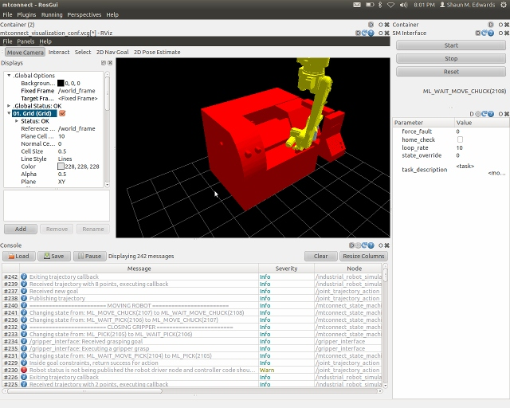
GUI Layer
ROS GUI
Qt based GUI
Powerful
Widget based
Cross platform (although ROS isn’t)
ROS-I GUI (Future)
Generic pendant
Standard industrial UI
Industrial Widgets

Slide 54
Applications Building
Create MoveIt configuration for your application
Verify configuration with physical robot cell (exercise 4.3)
Tweak motion to meet your needs (exercise 4.4)
Build your application code (application specific)
Build GUI interface (application specific)

Slide 55
Machine Tending Application
Robot, CNC, & Caging
Verify robot and physical layout
Fast motion for large moves, fine motion for interfacing with external equipment
Create industry standard state machine (start, stop, fault reset interface)
Create GUI that has buttons for changing modes, error logs, visualization.

Slide 56
Robot Package Verification
Exercise 4.3 https://aeswiki.datasys.swri.edu/rositraining/Exercises/4.3

Slide 57
Improving Robot Motion
Exercise 4.4 https://aeswiki.datasys.swri.edu/rositraining/Exercises/4.4

Slide 58
Future ROS-I Development

Slide 59
Outline
What the Future Holds
Please Share Your Ideas

Slide 60
Objectives
Tell you where we are going
Ask you where you want us to go

Slide 61
What's next?
Catkin
Github migration
Flexible robot IO control
Improved drivers (vendor supported)

Slide 62

Process Based Planners

Slide 63
Standard GUI

Slide 64
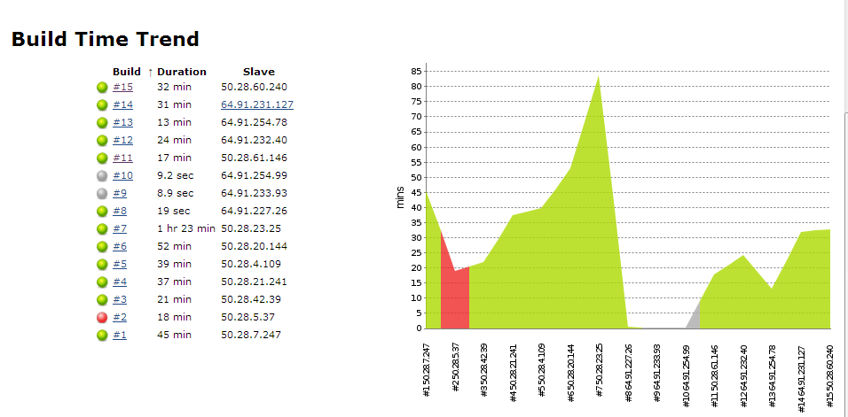
Code Metrics/Unit Tests
Jenkins continuous integration

Slide 65
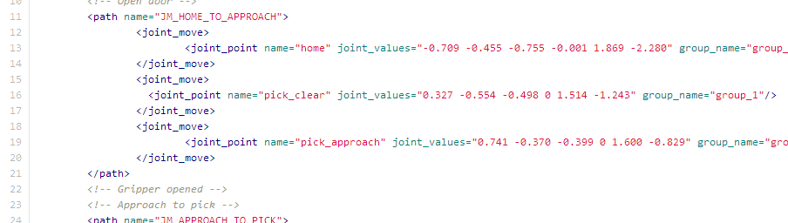
Robot Task Description Format
XML file format for describing arbitrary motion
Expressive enough for high/low density waypoints
Encapsulates process data

Slide 66
Roadmap
ROS-I Wiki (follow): http://ros.org/wiki/Industrial/Roadmap

Slide 67

What do YOU want?

Slide 68
Introduction to Perception

Slide 69
Outline
Explanation of the Perception Tools Available in ROS
Kinect Introduction

Slide 70
Objectives
Cursory understanding of the perception tools
Experience with Kinect data and tools

Slide 71
Example: Pick & Place

Slide 72
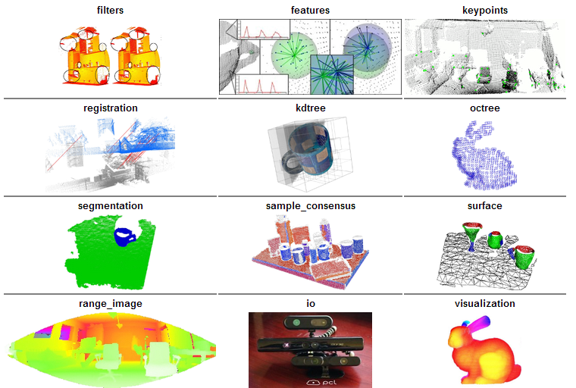
Perception Libraries
Point Cloud Library (PCL) - http://pointclouds.org/
Focused on 3D Range(Colorized) data
http://pointclouds.org

Slide 73
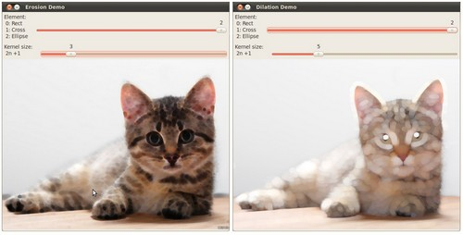
Perception Libraries
Open Computer Vision Library (OpenCv) - http://opencv.org/
Focused on 2D images
2D Image processing
Video
Sensor calibration
2D features
GUI
GPU acceleration
http://opencv.org

Slide 74
ROS Bridges
OpenCV & PCL are external libraries
“Bridges” are created to adapt the libraries to the ROS architecture
OpenCV: http://ros.org/wiki/vision_opencv
PCL: http://ros.org/wiki/pcl_ros
Standard Nodes: http://ros.org/wiki/pcl_ros#ROS_nodelets

Slide 75
Many More Libraries
Many more libraries in the ROS Ecosystem
AR Tracker - http://www.ros.org/wiki/ar_track_alvar
Object Recognition - http://www.ros.org/wiki/object_recognition
Robot Self Filter - http://www.ros.org/wiki/robot_self_filter
Let me Google that for you ☺ - http://bit.ly/12PebaA

Slide 76
Exercise
Exercise 4.5 - https://aeswiki.datasys.swri.edu/rositraining/Exercises/4.5

Slide 77

Contact Information
Shaun Edwards Senior Research Engineer
Southwest Research Institute
6220 Culebra Rd.
San Antonio, TX 78251 US
Phone: 210-522-3277 Email: sedwards@swri.org
www.rosindustrial.org
www.ros.org/wiki/Industrial

